Slide 1

Cloze
In 1812. Napoleon Bonaparte, Emperorof thee French, led his Grand Army
into Russia. He was prepared for (1)the fierce resistance of the Russian people defending their homeland. He was prepared for(2) the long march across Russian soil to Moscow, the capital city. But he was not prepared for(3) the
devastating enemy that met him in Moscow the -----raw ,bitter, (4) bleak Russian winter.
In 1941, Adolf Hitler, leader of Nazi Germany,(5) launched an attack against the Soviet Union, as Russia then was called. Hitler's (6) military might was unequaled. His war machine had (7) mowed down resistance in most of Europe. Hitler expected a short (8)campaign but, like Napoleon before him, was taught (9)a painful lesson. The Russian winter again came to (10) the aid of the Soviet soldiers.
A. the aid B. painful lesson C. bleak
D. the fierce resistance of E. the devastating enemy F.the long march G. launched H. military might
E. mowed down J.campaign

Slide 2
Cloze
When Hitler decicd to launch his invsion(1) of Russia,
he thought that nothing could stand in the way (2) of his armies. Conquest(3), it seemed, was inevitable. He had surprise on his side, catchng Stalin off his guard (4)by launching (5) his attack without a declaratian (6) of war. Hitler expected the campaign (7)to last only a few months,In the event, it was to drag on (8) for much longer. Like Napoleon before him, he had made a fatal mistake in failing to
rerkon with (9) the seventy of the Russian weather, Many German soldiers were to die from the cold as winter set in,bringing the German advance to a halt.
campaign
A. bringing ... to a halt B. invsion C. rerkon with
D.stand in the way E. drag on F.Conquest
G. campaign H.catchng... off his guard
E. declaratian J.launching

Slide 3
Cloze
攻势已经持续了三天，但是我们并没有取得多少进展。师长(division commander)命令我们营(battalion)夜晚绕到敌人后方发起突然袭击。然而，要绕到敌人后方，我们必须越过一片沼泽地(marshland)。我们很多人担心会陷入沉潭之中，我们营长决定宣一下险。所幸由于寒冷天气沼泽地都结上了冰、我们于天亮前到达目的地并从敌人后方发起进攻。这一下扭转了战局。敌人没有戒备，不久便投降了。
The offensive had already lasted three days, but we had not gained much ground. The divison commander instructed our battalion to get around to the rear of the enemy at night and launch a surprise attack. To do so, however,we had to cross marshland and many of us were afraid we might get bogged down in the mud, Our battalion commander decided to take a gamble. Lucky enough, thanks to the severely cold weather which made the marchland freeze over,we arrived at our destination before dawn and began attacking the enemy from the rear This turned the tide of the battle. The enemy,caught off guard, soon surrendered.

Slide 4

New College English Book 4
Unit Two
Smart Cars

Slide 5
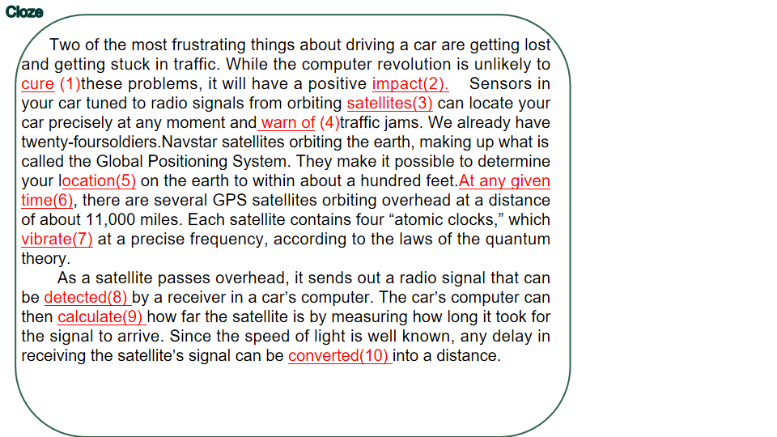
Cloze

Slide 6
Text-related Cloze
Hello. Welcome to your new car. I am your onboard (1) driving system. From the moment you (2) the car,I'll (3) help you. It is my job to (4)you to any (5) that may occur on the road. When you find the driving (6) and want to relax, I can (7) the car and (8) it in your place. r'll guide you from one (9) to another and make sure you ariver at your destination safe and sound. If a car in front of you slows down suddenly, I'll (10) your speed .And I'll (11) the data provided by the GPS system and choose the less busy routes so as to (12) your worries of (13)a trafic jam. When you want to convert back from manual contol, that's easy.Just press the right button (14) on the steering column But do remember not to take any alcooholic drinks.If I (15) the presence of alcoholin in the (16) of your breath, I'll stop the car whether you like it or not.
computerized
start up
be poised to
alert
hazards
monotonous
take control of
steer
lane
decrease
calculate
eliminate
getting stuck in
mounted
detect
vapor
campaign
A.hazards B.monotonous C.lane D.steer E.calculate
F.decrease G. monotonous H. be poised to I.mounted
J take control of K.detect L.start up
M. eliminate N.getting stuck in Ocomputerized. P. vapor

Slide 7
Translation
汽车自从发明以来使交通运输发生了革命性的变化，永远地改变了人们的生活、旅行和办事的方式。但另一方面，也带来了危害，尤其是公路死亡事故。然而，现今由于计算机技术和电子传感器的使用，有可能消除发生的大多数交通事故。例如，装在你汽车上的电子传感器能检测到空气中的酒精雾汽并拒绝启动引擎。同样，传感器还能通过接受在轨道上运行的卫星发出的信号监测路况并大大减少你陷入交通拥堵的可能性。
Automobiles have, since ther invention, revolutionizd transportation,changing forever the way people live, travel and do business. On the other hand, they have brought hazards, especialy highway fatalities. However, today the application of computer technology and electronic sensors in designing and manufacturing cars makes it possible to eliminate most of traffic accidents. For example, lectronic sensors mounted in your car can detect alcohol vapor in the air and refuse to start up the engine. They can also monitor road conditions by receiving radio signals sent out from orbiting satellites and greatly reduce your chances of getting stuck in traffic jams.

Slide 8

Unit3 Job Interview
Text A Get the Job You Want

Slide 9
Read Aloud
Had he _______ _______ (1) his university to see if there were any graduates working at Mackay whom he could ___________(2)? Had he asked any friends to ________(3) him in a mock interview? Did he go to the library to find newspaper __________(4) on us?
Did he write a letter beforehand to tell us about himself, what he was doing to prepare for the interview and why he'd _____ ________ ______(5)the job? Was he planning to ________ ______(6) the interview with another letter __________(7) his eagerness to join us? Would the letter be in our hands within 24 hours of the meeting possibly even _____________ (8)?
The answer to every question was the same: no. That left me with only one other question: How well _____________(9) would this person be if he were to call on a ___________(10) customer for us? I already knew the answer.
checked with
interview
grill
clippings
be right for
follow up
indicating
hand-delivered
prepared
prospective
A.interview
B.be right for
C.clippings
D.prospective
E.grill
F.follow up
G.indicating
H.prepared
I.hand-delivered
J.checked with

Slide 10
Cloze
What is the best way to impress a ___________(1) employer when you go for a job ineview?_____ ____ _____ ______(2) , the best thing is to demonstrate that you have _______ _____ __________(3) and know all about the firm ___________(4). You should make every ________(5), for example, to show that you know something about the ________(6) of the company, including the different lines of products it turns out and the chief business _________(7)it is working with. ________(8) in a spontaneous manner and let the interviewer know that you are not frightened by new challenges, but are willing to ______ _____ _______(9) at anything. Try to look at the situation ______ _____ __________(10) of the person offering the opportunity of employment. What sort of qualities is he likely to be looking for? Enthusiasm, certainly. So don't leave your application waiting until just before the deadline. Apply early. Another thing that can _____ _____ __________(11) is to __________ ______(12) your interview with a letter expressing your enthusiasm to join the company.
prospective
As I see it
done
your homework
beforehand
endeavor
structure
partners
Respond
take a crack
from the standpoint
make a difference
follow up
E.partners
A.respond
B.take a crack
C.endeavor
D.done your homework
F.follow up
G.from the standpoint
H.beforehand
I.structure
J.as I see it
K.prospective
L.make a difference

Slide 11
Passage Translation
常言道，好的开端是成功的一半。在求职时，求职者事先做好充分的准备是非常重要的，我认为，事先做不做准备显然会影响求职者的成功机会。我的一位朋友在一家大型计算机软件公司供职，年薪十万美元左右。他根据自己的经历告诉我说，那些面试未来雇员的具有录用决定权的人喜欢有充分准备的人，那些没有在了解未来雇主方面尽全力的人很难有成功的希望。
Well begun, half done, as the saying goes. It is extremely important for a job applicant to do his homework while seeking employment. From my standpoint, whether or not one has done his homework clearly makes a difference in his chance of success.
I have a friend who is earning somewhere in the neighborhood of 100,000 dollars a year in a large computer software company. He told me that from his own experience the decision makers who interview prospective employees like people who are well prepared. Those who make no endeavor to learn as much about his prospective employer as possible don't have much of a chance of success.

Slide 12
New College English volume 4
Unit 4 Globalization

Slide 13
Read Aloud
Although Browder and Mandl define their nationality differently,______ ______ _______ _________ (1) as a matter of personal choice, not an accident of ________(2). And ______ ____________(3), both are Davos Men, members of the international business élite who trek each year to the Swiss Alpine town for the ______ __(4) meeing of the Word Economic Forum, founded in 1971. This week. Browder and Mandl will join more than 2,200 executives,politicians, academics, journalists, writers and a handful of Hollywood stars for five days of ___________ (5), parties and endless earnest discussions about everything from post-election Iraq and HIV in Africa to the global supply of oil and the _____________(6)of nanotechnology. Yet this year,perhaps more than ever, a hot topic at Davos is Davos itself. _________ ________ ______________ ____________(7),most Davos Men and Women share at least one belief: that globalization, the ____________ ________(8) of capital,labor and technology across national borders, is both welcome and unstoppable. They see the world increasingly as one vast,_________________ ______________(9) in which corporations search for the most _______________ _(10) locations to buy, produce and sell their goods and services.
both see their identity
birth
not incidentally
annual
networking
implications
whatever their considerable differences
unimpeded flows
interconnected marketplace
advantageous
A.unimpeded flows
B.whatever their considerable differences
C.not incidentally
D.networking
E.birth
F.interconnected marketplace
G.annual
H.implications
I.advantageous
J.both see their identity

Slide 14
Cloze
Davos is a small Alpine city in eastern Switzerland which began making itself known in the 1990s for hosting the World Economic Fornum, an annual gathering of politicians, financiers and __________(1). Each year, those taking part spend five days there __________(2) and discussing
_____ ___________ ______(3) issues such as the global supply of oil, world economic _________(4) and environmental problems.
Davos Men share the belief that globalization is both welcome and unstoppable.They would like to see national boundaries _________(5) so as to ___________(6) their global operations. Some people say that this international perspective is a minority elitist position not shared by the majority of people. Others, however, argue that __________(7) global _________(8) does not mean _________ ______(9) one's ________(10) feelings or _________(11) one's national identity. The question, perhaps, is whether it is possible to _________ ______ _________(12) between being global and being local.
academics
networking
a variety of
growth
vanish
facilitate
endorsing
outlook
sweeping aside
patriotic
erasing
strike a balance
A.networking
B.outlook
C.erasing
D.strike a balance
E.vanish
F.sweeping aside
G.patriotic
H.facilitate
I.growth
J.academics
K.a variety of
L.endorsing

Slide 15
Passage Translation
全球化对中国年轻人具有重大影响。例如， 年轻的农民正在大规模流向城市寻找工作。而对那些想出国深造或进外企工作的年轻人来说，英语变得越来越重要。另一方面，许多海外学子近年来回归祖国，因为他们看好中国经济的长期增长前景。因特网加强了中国年轻人和其他地方年轻人的联系。他们跟踪最新的潮流，模仿外国的时尚。他们中一些人似乎不在乎中国的传统美德，更不要说发扬光大，这使得有人忧虑中国传统文化会不会有一天终将消失。
Globalization has great implications for young Chinese. For example, young farmers are moving on a large scale to urban areas to look for jobs. And for those young people who aspire to study abroad or work in foreign-ivested enterprises,English has become increasingly important. At the same time, a considerable number of overseas Chinese students have returned home in recent years, for they hold an optimistic outlook for the long-term growth of the Chinese economy. The Internet has strengthened the links between Chinese young people and those elsewhere. They follow the latest trend and copy foreign fashions. Some of them don't seem to care for traditional Chinese virtues, let alone carry them forward, which has given rise to worries that the traditional Chinese culture might one day vanish.

Slide 16
New College English volume 4
Unit 5 Never Judge by Appearances
Lesson 1

Slide 17
Read Aloud
I think the chief thing that ________(1) me about Burton was his kindliness. There was something very pleasing in his ________(2) blue eyes. His voice was _________(3); you could not imagine that he could possibly ________ _____(4) in anger; his smile was _________(5). Here was a man who attracted you because you felt in him a real love for his fellows At the same time he liked his game of cards and his cocktail, he could tell ______ ______(6)a good and spicy story, and in his youth he had been ___________ _____(7) an athlete. He was a rich man and he had ______ _______ _______(8) himself. I suppose one thing that made you like him was that he was so _______ _____ _______(9); he aroused your instincts of protection. You felt that he could ___ _____ ___ _____ ___ ______(10).
struck
mild
gentle
raise it
benign
with point
something of
made every penny
small and frail
not bear to hurt a fly
A.benign
B.raise it
C.something of
D.struck
E.gentle
F.with point
G.mild
H.small and frail
I.made every penny
J.not bear to hurt a fly

Slide 18
Cloze
You see that young man swimming out at sea?He's trying to swim out to the beacon and back.He must be _______(1) to have committed himself to such a thing. The ________(2) is far too strong. To be _________(3), I wouldn't attempt it. I dare say few swimmers are __________(4) of such a feat. I met him on the beach before he set out. I don't mind telling you that I _____ ________ ________(5) when he told me what he was going to do, because he didn't look ____ ______ _________(6) at all. Far from it. He may have had a good ___________(7) once, but he had clearly let himself ____ _____ ____ _______(8). However, it seems like he had no choice. He told me that he had _____ _______(9), not a penny left, and that old Burton would only find him a _________(10) in his firm if he did the swim. That was another surprise. Burton seems such a _______(11)-mannered man, kind to everybody. Perhaps he thought the young man would not have the courage, that he would funk it. Then, again, perhaps Burton knew he was sending the young man to his death, but was too cold-blooded to care. It only goes to show __________(12) appearances can be.
insane
current
candid
capable
was taken back
in good condition
constitution
go all
to pieces
gone broke
vacancy
mild
deceptive
A.mild
B.insane
C.gone broke
D.in good condition
E.candid
F.go all to pieces
G.constitution
H.current
I.deceptive
J.vacancy
K.was taken back
L.capable
constitution

Slide 19
Passage Translation
就我来说，我发现外表往往是靠不住的。 譬如，要是你仅凭外表去判断诸如爱德华 · 海德 · 伯顿这样的人，你就错了。 外表上，伯顿像是个表里一致的人。 他个子很小，满头白发，有着一双
温和、蔚蓝的眼睛，文雅且坦率。然而，他原来却是十分的残忍。他侮辱和愚弄穷困潦倒的伦尼,让他去做那样的蠢事。更让人吃惊的是，他对伦尼的死全然冷漠无情。毫无疑问,他是个铁石心肠的家伙。
For my own part, I find that appearances are all too often deceptive. For instance, you might be wrong if you judged by appearances only people like Edward Hyde Burton. In appearance, he seemed a man all of a piece. He was a tiny little fellow with white hair and mild blue eyes, gentle and candid. Nevertheless, he turned out to be very cruel. He insulted and fooled Lenny who was down and out and made him commit himself to an insane venture. What was still more surprising was that he was completely indifferent to Lenny's death. Without doubt, Burton was a man with a heart of stone.

Slide 20

Unit3 Job Interview
Text A Get the Job You Want

Slide 21
Read Aloud
A more successful remedy may lie in _______________(1) the problem rather than evading it.
Before the industrial revolution, people lived in small communities with limited communications. ________ _____ ________(2) of their village, they could __________(3) expect to know everything that was to be known, see everything that was to be seen, and do everything that was to be done.
Today, being curious _____ _______(4), we are still trying to do the same. But the global village is a world of _________ ___________(5), and we can never achieve ______ ______(6).
It is not more time we need: it is ________ ________(7). We need to switch off the cell-phone and leave the children to ______ _____ ___________(8). We need to buy less, read less and travel less. We need to _____ ___________(9) for ourselves, _____ (10) be doomed to mounting despair.
understanding
within the confines
reasonably
by nature
limitless possibilities
our
aim
fewer desires
play by themselves
set boundaries
or
A.reasonably
B.understanding
C.within the confines
D.play by themselves
E.or
F.our aim
G.set boundaries
H.fewer desires
I.by nature
J.limitless possibilities

Slide 22
Cloze
Can you ________ ______(1) from the cares of life and relax? Many people today cannot. They feel instead that they are __________(2) to be _____ ______ _____(3) all the time. The pace of life seems to grow ever faster. As a result, feelings of stress are common as people struggle to ______(4) with what they see as a __________(5) of time. Such widespread feelings are in part caused by the _______ __________ _____(6) information that comes _________ _____(7) on us.“All men," said Aristotle,“______ ________(8) desire to know." But it is no longer possible, as it was in the past, for an individual to master the whole range of human knowledge. Instead, any individual, no matter how smart he is, can only command a ___________(9) of the total knowledge available. It may be argued that it is __________(10) to even attempt to do so. We should learn to set more realistic goals for ourselves if we are to hope to escape from the tyranny (专制) of time.
switch off
obliged
on the go
cope
shortage
large quantity of
pouring in
by nature
fraction
futile
A.fraction
B.shortage
C.obliged
D.cope
E.switch off
F.by nature
G.on the go
H.pouring in
I.large quantity of
J.futile

Slide 23
Passage Translation
当今我们处于持续的压力之下，要工作更长的时间，要生产更多，拥有更多。许多人有一种错误的认识：幸福就在于拼命地干，使劲地赚。
许多妇女今天感到同样的压力，要工作，要出人头地，而与此同时，又要养育子女，承担起家庭责任的负担。
研究表明，工作狂(workaholism) 往往使我们与家人的关系疏远。它会迫使我们长时间辛苦劳作，仅留微乎其微的时间与我们的亲人呆在一起、交流感情。家庭成员间的亲密关系在此过程
中注定要消亡。
Today we are under constant pressure to work longer hours, to produce more, and to possess more. Lots of people hold the wrong perception that happiness lies in working hard and earning well / good money.
Many women today feel the same stress to work and get ahead and, at the same time, to nurture their offspring and shoulder the burden of domestic responsibilities.
Research shows that workaholism tends to distance us from our immediate families. It forces us to toil longer and longer hours, leaving a minute fraction of our time to be physically and emotionally available to our loved ones. Intimacy among family members is doomed to die in the process.

Slide 24
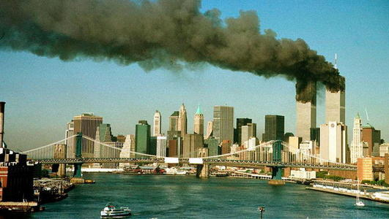
Unit 7 :
Text A
Unit 7 Snapshots of New York’s Mood after 9/11

Slide 25
Read Aloud
Long before the Boeings _________ _______(1) the towers poet Percy Bysshe Shelley wrote “grief returns with the ___________(2) year." So it is with New York.
The time it took the Earth to ________(3) the sun was time enough to clear the _________(4), but not enough to fade the _________(5) of what happened there.
It was time enough to ______(6) the bodies that could be found, but not enough to truly mourn the thousands who _________(7).
It was time enough to plan __________(8), but not enough to fill the _________ _________(9) in lower Manhattan.
For what is a year but a thin _________(10) of history, a beat of a hummingbird's wing?
brought down
revolving
circle
wreckage
memory
bury
perished
emorials
gaping wound
silver
A.bury
B.silver
C.wreckage
D.revolving
E.circle
F.emorials
G.memory
H.gaping wound
I.brought down
J.perished

Slide 26
Cloze
Corky Siemaszko's snapshots provide us with an insight into the _______(1) of the American people following the _________(2) events of 9/11. They start with two pieces written _____ ______ immediate __________ _____(3) the attack. These clearly reveal the state of _______(4) into which New Yorkers felt they had been plunged by the __________(5) of the twin towers. Balancing widespread feelings of shock came the welling up of a strong sense of ___________(6) with each other in the face of a common enemy. Together with this came a natural desire to _______ __________ ______(7) those responsible. A year later the snapshots reveal a city and a nation _________ _______ ______(8) the fateful events of 9/11 while __________(9) those who __________(10) in the attacks.
mood
tragic
in the
aftermath of
chaos
toppling
solidarity
take
revenge on
thinking back on
mourning
perished
A.perished
B.tragic
C.chaos
D.thinking back on
E.solidarity
F.mourning
G.mood
H.in the aftermath of
I.take revenge on
J.toppling

Slide 27
Passage Translation
今天，在地震袭击我的家乡很久以后，我仍然能历历在目地回想起我与父母从家里逃出来时所看到的情景。马路对面的房子就在我们的眼前倒塌，瓦砾四处乱飞，呛人的尘云遮住了太阳。惊恐的人们哭叫着四处奔跑。
如今那一场悲惨事件已过去多年，旧城的废墟上已耸立起一座新城，人们在小镇广场上建起了一个纪念碑，以怀念那些灾难中的死者。 看来人们心中的创伤已愈合， 但对此事的记忆将不会消失。
Today, long after the earthquake shook/hit my home town, I can still recall, in crystal detail, what I saw as I ran out of my home with my parents. The building just across the street toppled right before our eyes, debris flew everywhere and a cloud of choking dust blotted out the sun. Horror-stricken people ran in all directions, crying and screaming.
Now, many years after that tragic event, a new towm has risen on the wreckage of the old one. In the town square, a memorial has been built to remember those killed in the disaster. It sems the wounds in pople's hearts have healed, but the memory will linger.

Slide 28
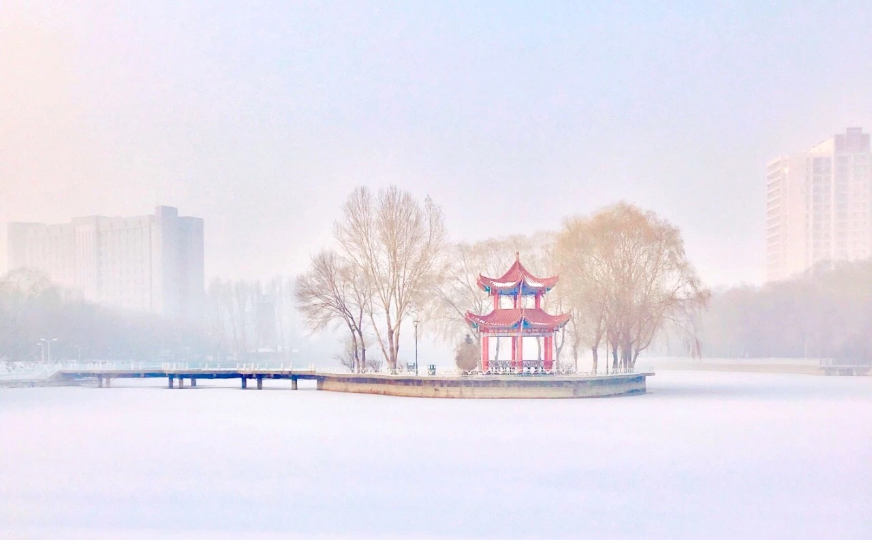

New College English 4
Unit 8 Go Traveling

Slide 29
Read Aloud
The point of going somewhere like the Napo River in Ecuador is not to see the most spectacular anything. It is simply to see what is there. We are here _____ _____ ________(1) only once, and might as well get ____ _______ ______(2) the place. We might as well get a feel for the ________ ______ ________(3) in which life is lived, for the Amazon basin, which covers _______ _____ __________(4), and for the life that — there, like anywhere else — is always and necessarily lived ______ _________(5): on the tributaries, in the riverside villages, ________(6) this particular white-fleshed guava in this particular pattern of ________(7).
What is there is interesting. The Napo River itself is wide and brown, opaque, and _________ _______(8) floating foam and logs and branches from the jungle. Parrots _____ ________(9) dart in and out of the light. Under the water in the river, unseen, are anacondas — which _____ _________ _____(10) take a few village toddlers every year — and water boas, crocodiles, and sweet-meated fish.
on the planet
a feel for
fringes
and hollows
half a
continent
in detail
sucking
shade
in flocks
smeared
with
are reputed
to
A.a feel for
B.in detail
C.smeared with
D.half a continent
E.in flocks
F.sucking
G.shade
I.are reputed to
H.on the planet
J.fringes and hollows

Slide 30
Cloze
If you ______ ________ ______(1) find out what it is like _____ ______ ________ _____(2)the tropical jungle, you should make a trip on the river. This is better than walking through the trails in the forest, as these are often blocked by undergrowth that gets ________(3) in your feet and makes traveling difficult. In a dugout canoe, you can sit back and enjoy the scenery while the guide _________(4) it along the rivers that _______(5) their way through the forest. Everywhere you go, you can hear the clatter of birds, hidden ______ _____ _______(6), deep in the jungle. At other times, they are clearly visible, circling _____ ________(7) overhead. And you can also see some of them _________(8) about in the clearings and others _________(9) on the _________(10) waters. But birds are not the only wildlife. From time to time, you can spot enormous black fish ___________(11) about in shallow water. Or if you look closely enough, you can see some small animals __________(12) in and out of the bushes. Indeed, the whole jungle _________(13) with a huge variety of animal life, guaranteed to make your trip a ___________(14) event that you will never forget.
are dying to
in the heart of
tangled
paddles
loop
out of sight
in flocks
hopping
gliding
opaque
thrashing
darting
swarms
spectacular
A.swarms
B.thrashing
C.spectacular
D.paddles
E.loop
F.gliding
G.in flocks
H.opaque
I.darting
J.hopping
K.out of sight
L.are dying to
M.tangled
N.in the heart of

Slide 31
Passage Translation
上星期三，我和我的同学卡罗林一起游览了周庄，那是一个四周环水的著名城镇。当我们到达镇上时， 卡罗林激动地向她着见的第一座桥飞奔过去，然后便在那里高声唱了起来。突然她的嗓音静了下来，原来她发现自己惊动了离我们不远处的一群鸭子，当时卡罗林太想乘船了，于是我们决定坐船游览该镇。卡罗林跟河里所有的动物时而高声、时而低语地说着话并且不停地瞎忙乎，而我则默默地看着船儿在水面上轻轻地滑过。虽然我们没有见到任何壮观的景物，我们享受了在这个远离大城市喧器的镇里度过的每一分钟，
周庄是值得游览的。如果有时间，我还想再次去那里。
Last Wednesday my classmate Caroline and I visited Zhouzhuang, a well-known town looped all around by streams. When we arrived at the town,Caroline was so excited that she darted towards the first bridge she saw and began singing loudly there. Suddenly her voice hushed when she found that she had startled a flock of ducks not too far from us. Now as Caroline was dying for a boat ride, we decided to tour the town by boat. Now loud, now soft, Caroline talked to all the creatures in the stream and was fussing about everything while I looked at the boats gliding over the water in silence. Though we did not see anyhing spectacular, we enjoyed every minute in the town that lies out of the range of the heavy traffic and noise of the large city.
Zhouzhuang is worth visiting and, time permitting, I'd like to go there again.

